Slide 1
Subprocess

Slide 2
Subprocess
The subprocess is a standard Python module designed to start new processes from within a Python script.
run multiple processes in parallel or call an external program or external command from inside your Python code
the subprocess module is that it allows the user to manage the inputs, the outputs, and even the errors raised by the child process from the Python code.

Slide 3
Subprocess.run
subprocess.run(args, *, stdin=None, input=None, stdout=None, stderr=None, capture_output=False, shell=False, cwd=None, timeout=None, check=False, encoding=None, errors=None, text=None, env=None, universal_newlines=None, **other_popen_kwargs)

Slide 4
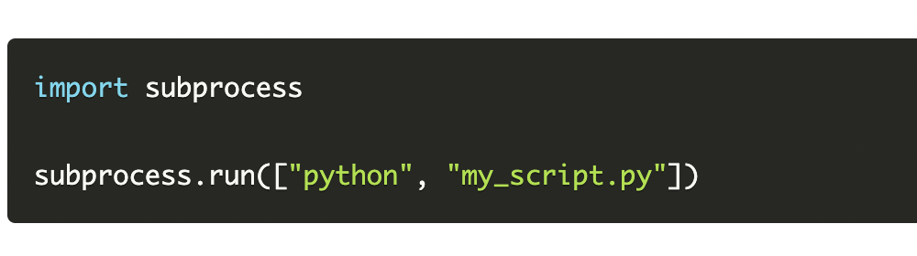
Using subprocess.run()
The run function of the subprocess module in Python is a great way to run commands in the background without worrying about opening a new terminal or running the command manually.

Slide 5

Run code directly
It's also possible to write Python code directly to the function instead of passing a .py file. Here's an example of running such a subprocess:

Slide 6
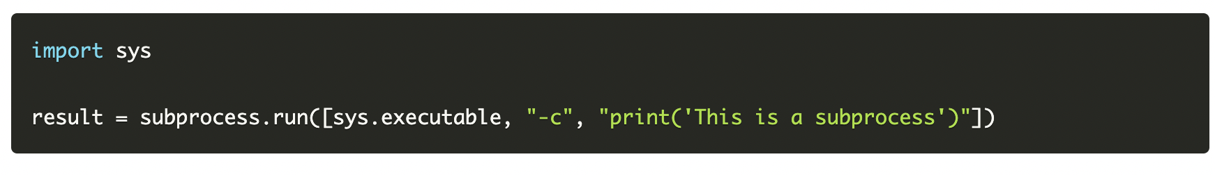
Subprocess execution
Print Result

Slide 7
Send output and error to file from shell command
SomeCommand >> SomeFile.txt
SomeCommand &> SomeFile.txt

Slide 8
Controlling the Outputs
Import subprocess
result = subprocess.run(["python", "-c", "print('This is a subprocess')"], capture_output=True)
print(result)
CompletedProcess(args=['/usr/bin/python3', '-c', "print('This is a subprocess')"], returncode=0, stdout=b'This is a subprocess\n', stderr=b'')

Slide 9
Stdout and stderr
print(result.stdout)
print(result.stderr)
b'This is a subprocess\n’
b''

Slide 10
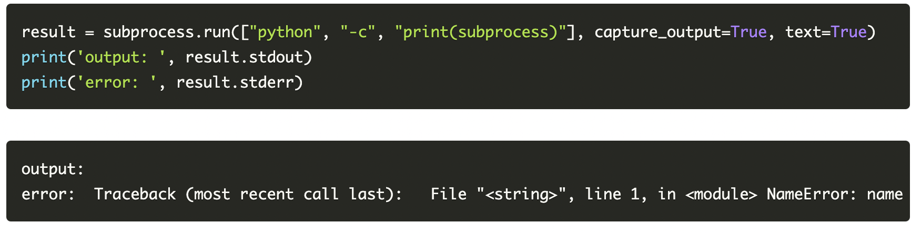
Result in text

Slide 11
result = subprocess.run(["pyhon", "-c", "print(subprocess)"], capture_output=True, text=True, check=True)
print('output: ', result.stdout)
print('error: ', result.stderr)

Slide 12
timeout
subprocess.run(["python", "-c", "import time; time.sleep(5)"], capture_output=True, text=True)
But if we set the timeout parameter to less than five, we'll have an exception:
subprocess.run(["python", "-c", "import time; time.sleep(5)"], capture_output=True, text=True, timeout=2)

Slide 13
Inputting in subprocess
result = subprocess.run(["python", "-c", "import sys; my_input=sys.stdin.read(); print(my_input)"], capture_output=True, text=True, input='my_text') print(result.stdout)

Slide 14
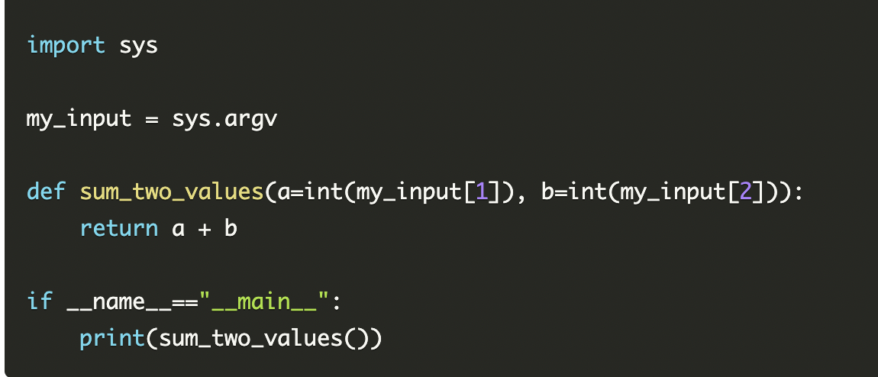
Command line arguments
result = subprocess.run(["python", "my_script.py", "2", "4"], capture_output=True, text=True) print(result.stdout)

Slide 15
Problem Statement
Parallel Backup system
Suppose we have very important data that we want to backup in 3 different place.
Create a program to copy files of a folder to the specific folder.
Run this process all three places parallelly using subprocess.

